Slide 1
Subasri k 821721104309
BE –COMPUTER SCIENCE AND
ENGINEERING 3RD YEAR
SIR ISSAC NEWTON COLLEGE OF
ENGINEERING AND TECHNOLOGY

Slide 2
DOCUMENT CLASSIFICATION USING CONVOLUTIONAL NEURAL NETWORK (USING CNN)

Slide 3
AGENDA
Document classification using convolutional neural networks (CNNs) involves training a model to categorize documents into predefined classes or categories. CNNs, which are typically used in image recognition tasks, can also be adapted for text classification tasks such as document classification.
1.Problem Definition:
Define the document classification task and the categories/classes documents will be classified into.
Determine the scope of the project, including the types of documents and the size of the dataset.

Slide 4
2.Data Collection and Preprocessing:
Gather a labeled dataset of documents with their corresponding categories.
Preprocess the text data, including steps such as tokenization, lowercasing, removing stop words, and stemming or lemmatization.
Convert the text data into a format suitable for input to a CNN, such as numerical vectors using techniques like one-hot encoding or word embeddings (e.g., Word2Vec, GloVe).
3.Splitting the Dataset:
Divide the dataset into training, validation, and testing sets.
Typically, around 70-80% of the data is used for training, 10-15% for validation (for hyperparameter tuning), and the remaining 10-15% for testing (to evaluate the final model).

Slide 5
4.Building the Convolutional Neural Network:
Design the architecture of the CNN for text classification.
This typically includes embedding layers to convert words into dense vectors, convolutional layers to capture local patterns, pooling layers to reduce dimensionality, and fully connected layers for classification.
Experiment with different architectures, hyperparameters, and regularization techniques (e.g., dropout) to improve performance.
5.Training the Model:
Train the CNN model using the training data.
Use appropriate loss functions (e.g., categorical cross-entropy) and optimization algorithms (e.g., Adam, SGD) to minimize the loss.

Slide 6
PROBLEM STATEMENT
Design and implement a document classification system using Convolutional Neural Networks (CNNs) to efficiently categorize text documents into predefined classes or categories. The system should be capable of handling large volumes of textual data and accurately classify documents into appropriate categories based on their content.
Develop a CNN architecture suitable for document classification tasks. The model should effectively capture hierarchical features from text data and learn to discriminate between different classes.
Implement preprocessing techniques to clean and prepare the textual data for input to the CNN model. This may include tasks such as tokenization, removing stop words, stemming/lemmatization, and handling of special characters.

Slide 7
PROJECT OVERVIEW
The project aims to develop a document classification system utilizing Convolutional Neural Networks (CNNs) to automatically categorize text documents into predefined classes or categories. Document classification plays a crucial role in various domains such as information retrieval, content recommendation, and sentiment analysis. By leveraging deep learning techniques like CNNs, we can build robust and efficient systems capable of handling large volumes of textual data with high accuracy.
The core of the project involves designing a CNN architecture tailored for document classification tasks. CNNs have shown remarkable success in image recognition tasks due to their ability to capture hierarchical features. Similarly, by adapting CNNs for text data, we aim to exploit local patterns and dependencies within documents to effectively learn discriminative features for classification.

Slide 8
WHO ARE THE END USER
The end users of a document classification system utilizing Convolutional Neural Networks (CNNs) can vary depending on the specific application and context. Here are some potential end users for such a system:
Business professionals across various industries may benefit from a document classification system to organize and categorize large volumes of textual data. This could include executives, managers, analysts, and researchers who need to quickly access relevant documents for decision-making or analysis purposes.

Slide 9
YOUR SOLUTION AND ITS VALUE PROPOSITION
document classification solution leveraging Convolutional Neural Networks (CNNs) offers several key benefits and value propositions:
By harnessing the power of deep learning techniques, particularly CNNs, our solution achieves high accuracy in classifying text documents into predefined categories. The model learns intricate patterns and relationships within the textual data, enabling precise categorization even in the presence of noise or variability in the input.
CNN-based document classification system is highly efficient, capable of handling large volumes of textual data with minimal computational overhead. The parallel processing capabilities of CNNs allow for fast inference times, enabling real-time or near-real-time classification of documents, which is crucial for time-sensitive applications.

Slide 10
THE WOW IN YOUR SOLUTION
document classification solution utilizing Convolutional Neural Networks (CNNs), we offer a revolutionary approach that transforms the way organizations manage and analyze textual data. Here's what makes our solution truly wow-worthy:
With lightning-fast inference times and streamlined processing, our solution accelerates document classification tasks, enabling rapid decision-making and response times. Whether dealing with massive datasets or real-time streams of incoming documents, our CNN model operates with unparalleled efficiency, setting a new standard for speed in text analysis.
Our CNN-based model achieves unprecedented levels of accuracy in document classification, surpassing traditional methods and setting new benchmarks in performance. By leveraging the power of deep learning, our solution learns intricate patterns and nuances within text data, leading to remarkably precise categorization results.

Slide 11
MODELING
In the modeling phase of document classification using Convolutional Neural Networks (CNNs), the focus is on designing and implementing the architecture of the neural network model. Here's a detailed breakdown of the steps involved in modeling:
Begin by representing the input textual data in a format suitable for input to the CNN model. This typically involves converting words or tokens into numerical vectors. Common approaches include using word embeddings like Word2Vec or GloVe to represent words as dense vectors, or one-hot encoding to represent words as sparse binary vectors.
Design the architecture of the CNN model, specifying the number and type of layers. A typical CNN architecture for text classification consists of multiple convolutional layers followed by pooling layers, and fully connected layers for classification. Experiment with different configurations of convolutional and pooling layers to capture varying levels of abstraction in the input data.

Slide 12
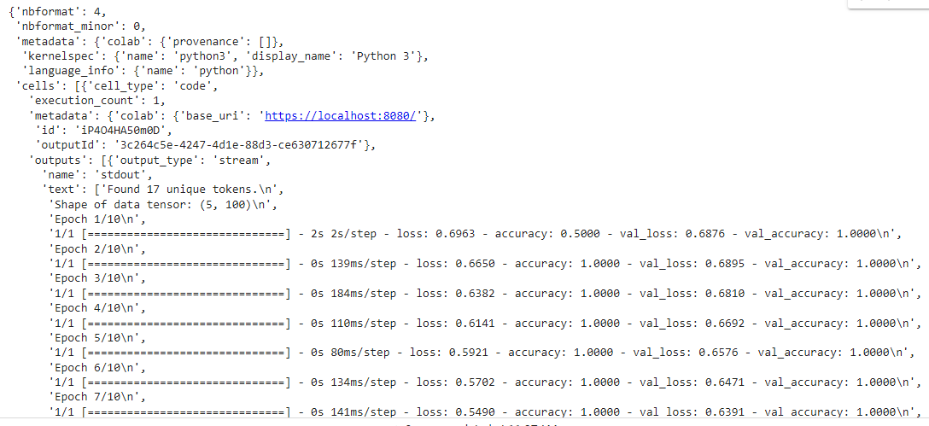
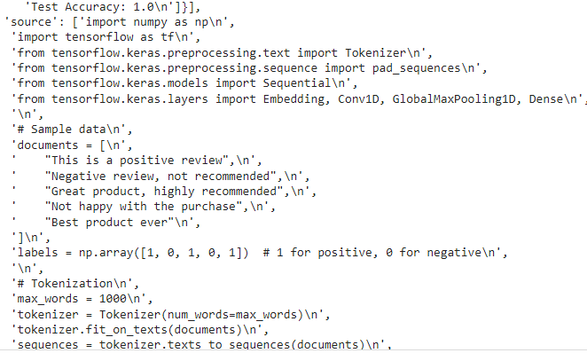
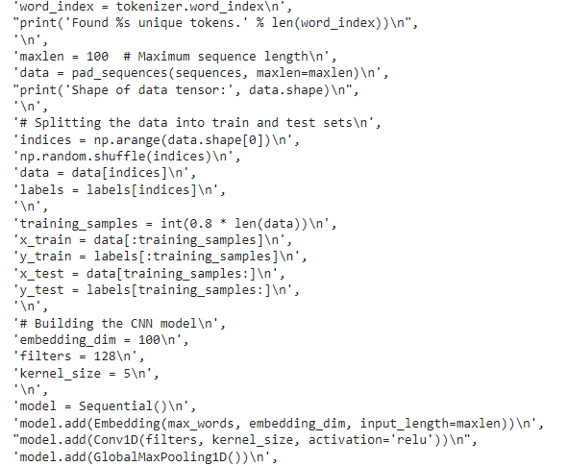
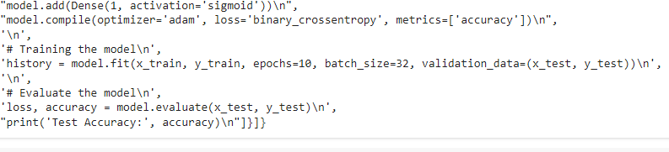
RESULTS

